Slide 1
ICT FINAL PROJECT
(personal portfolio)
Muhammad sohaib shoukat
21f-9181

Slide 2
HOME PAGE
Tells about me.
How I designed home page.
Which tools are being used.

Slide 3


Slide 4
PORTFOLIO
What is personal portfolio?
My portfolio contains.
Who I designed it.
Which tools are being used.

Slide 5
ABOUT ME
My personal information.
Who I am.
What I want to be.
What are my goals.

Slide 6
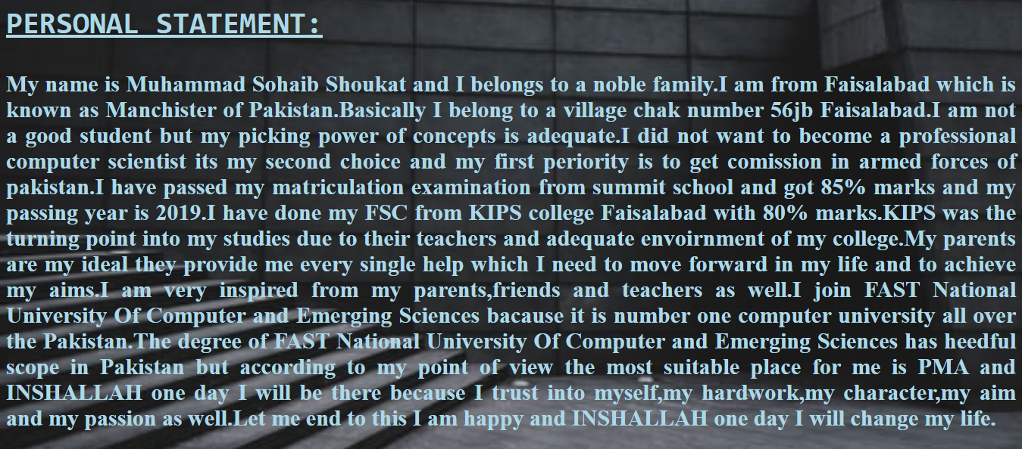

Slide 7
MY ACHIEVEMENTS
My marks in matric and FSC.
I got admission in FAST NUCES.
Silver medalist in sports.

Slide 8
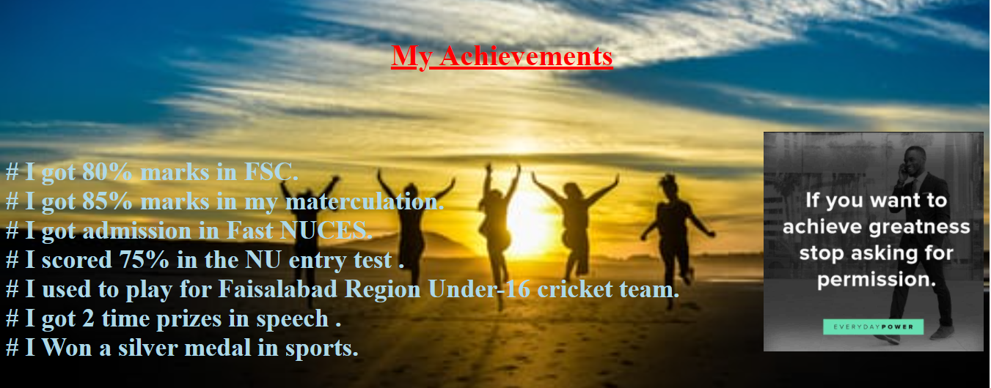

Slide 9
Thank you
(SOHAIB shoukat)

